Slide 1
CSE115
Lecture 15
Dr. Mohammad Abu Yousuf (MAY)

Slide 2
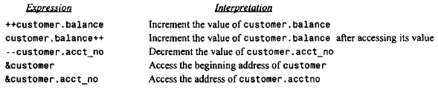
Several expressions involving the structure variable customer and its members are given below.

Slide 3
if a structure member is itself a structure, then a member of the embedded structure can be accessed by writing
variable. member. submember
where member refers to the name of the member within the outer structure, and sub member refers to the name of the member within the embedded structure.
To access the month of the last payment, we would therefore write
customer.lastpayment.month
Moreover, this value can be incremented by writing
++customer.lastpayment.month

Slide 4
Similarly, if a structure member is an array, then an individual array element can be accessed by writing
variable. member[ expression]
where expression is a nonnegative value that indicates the array element.
Example: The third member of customer is the character array customer. name. The third character within this array can be accessed by writing
customer.name[2]

Slide 5
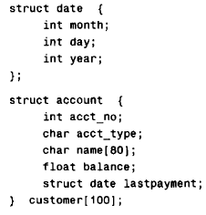
The use of the period operator can be extended to arrays of structures, by writing
array[ expression] .member
14th customer's balance can be accessed by writing customer[ 13]. balance. The corresponding address can be obtained as &customer[ 13]. balance.

Slide 6
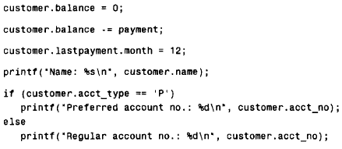

Slide 7
USER-DEFINED DATA TYPES (typedef)
The typedef feature allows users to define new data-types that are equivalent to existing data types. Once a user-defined data type has been established, then new variables, arrays, structures, etc. can be declared in terms of this new data type.
In general terms, a new data type is defined as
typedef type new-type;
where type refers to an existing data type (either a standard data type, or previous user-defined data type), and new- type refers to the new user-defined data type. It should be understood, however, that the new data type will be new in name only. In reality, this new data type will not be fundamentally different from one of the standard data types.

Slide 8
Example:
typedef int age;
In this declaration age is a user-defined data type, which is equivalent to type int. Hence, the variable declaration
age male, female;
is equivalent to writing
int male, female;
In other words, male and female are regarded as variables of type age, though they are actually integer-type variables.

Slide 9
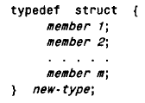
Define Structure using Tag
In general terms, a user-defined structure type can be written as
where new- type is the user-defined structure type. Structure variables can then be defined in terms of the new data type.

Slide 10
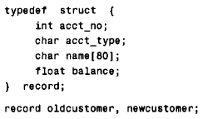
Example:
The first declaration defines record as a user-defined data type. The second declaration defines oldcustomer and newcustomer as structure variables of type record.
The typedef feature is particularly convenient when defining structures, since it eliminates the need to repeatedly write struct tag whenever a structure is referenced.

Slide 11
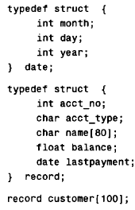
Example:

Slide 12
STRUCTURES AND POINTERS
The beginning address of a structure can be accessed in the same manner as any other address, through the use of the address (&) operator. Thus, if variable represents a structure-type variable, then &variable represents the starting address of that variable. Moreover, we can declare a pointer variable for a structure by writing
type *ptvar;
where type is a data type that identifies the composition of the structure, and ptvar represents the name of the pointer variable. We can then assign the beginning address of a structure variable to this pointer by writing
ptvar = &variable;

Slide 13
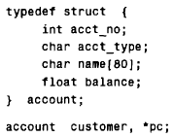
Example:
In this example customer is a structure variable of type account, and pc is a pointer variable whose object is a structure variable of type account. Thus, the beginning address of customer can be assigned to pc by writing
pc = &customer;

Slide 14
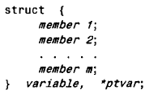
The variable and pointer declarations can be combined with the structure declaration by writing
where variable again represents a structure-type variable, and ptvar represents the name of a pointer variable.

Slide 15
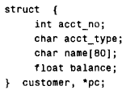
Example:
The beginning address of customer can be assigned to pc by writing
pc = &customer;
as in the previous example.

Slide 16
An individual structure member can be accessed in terms of its corresponding pointer variable by writing
ptvar- >member
where ptvar refers to a structure-type pointer variable and the operator -> is comparable to the period (.).
Thus, the expression
ptvar->member
is equivalent to writing
variable. 0ember
where variable is a structure-type variable

Slide 17
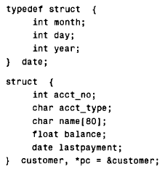
Example:
If we wanted to access the customer’s account number, we could write any of the following:
customer.acct-no pc->acct-no (*pc).acct-no
The parentheses are required in the last expression because the period operator has a higher precedence than the indirection operator (*). Without the parentheses the compiler would generate an error, because pc (a pointer) is not directly compatible with the dot operator.

Slide 18
The month of the last payment can be accessed by writing any of the following:
customer.lastpayment.month pc->lastpayment.month (*pc).lastpayment.month
Finally, the customer's name can be accessed by writing any of the following:
customer. name pc ->name (*pc).name
Therefore, the third character of the customer's name can be accessed by writing any of the following.
customer.name[2] pc->name[2] (*pc).name[2]
*(customer. name + 2) pc->(name + 2) *((*pc).name + 2)

Slide 19
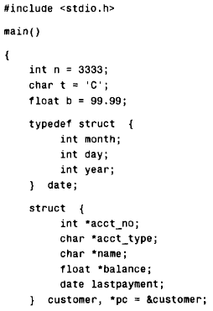

Slide 20
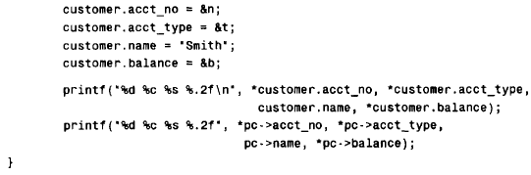

Slide 21
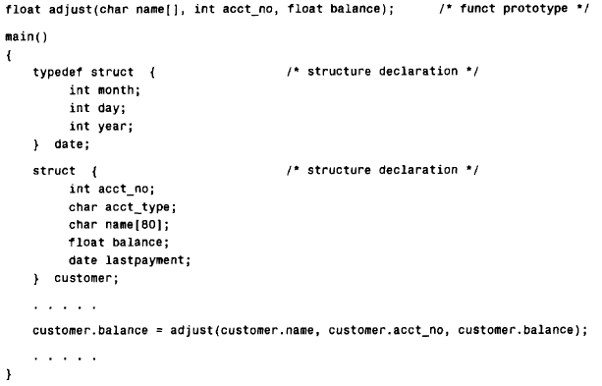
PASSING STRUCTURES TO FUNCTIONS

Slide 22
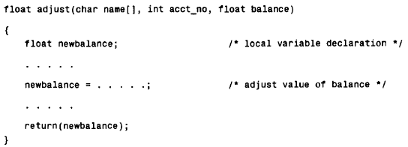

Slide 23
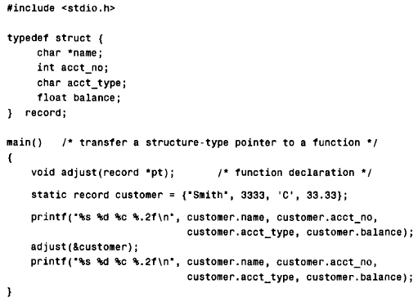
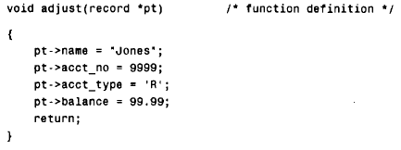
Example:

